Slide 1
Lecture 21: Market-based Environmental Regulations in Practice
Prof. Austin
Environmental Economics Econ 475

Slide 2
Part 1: Controversy Around Hernandez-Cortes and Meng

Slide 3
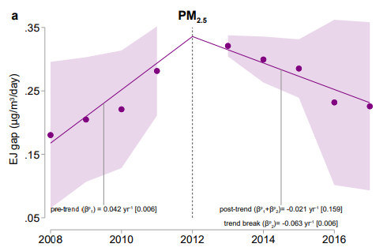
Recap
Last week, we saw from Hernandez-Cortes and Meng (2022) that California’s C&T program decreased EJ gaps within the state:
8.5% annual decrease in PM 2.5 emissions relative to control facilities
6.5% annual EJ gap percent change for PM 2.5

Slide 4
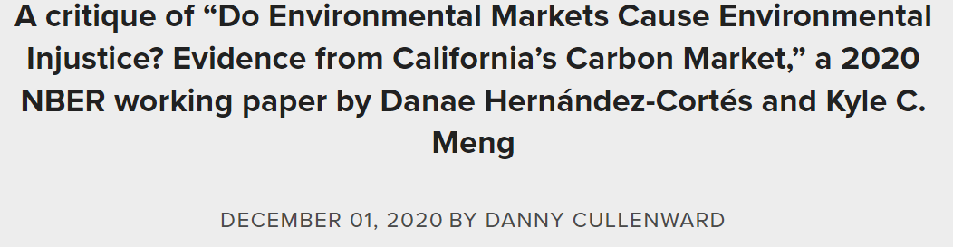
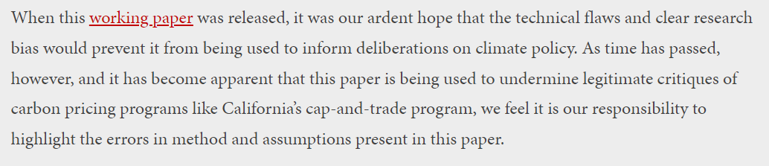
Controversy
Hernandez-Cortes and Meng (2022) was very controversial when a prior version in 2020 was released.
Danny Cullenwald and Katie Valenzuela’s response in 2020.

Slide 5

Cullenwald’s Critique
Five errors highlighted:
Inaccurate definition of environmental justice communities
Data quality issues with emissions reporting and monitoring
Control group bias
Omitted variable bias
The question is not cap-and-trade vs. nothing
Image source.

Slide 6
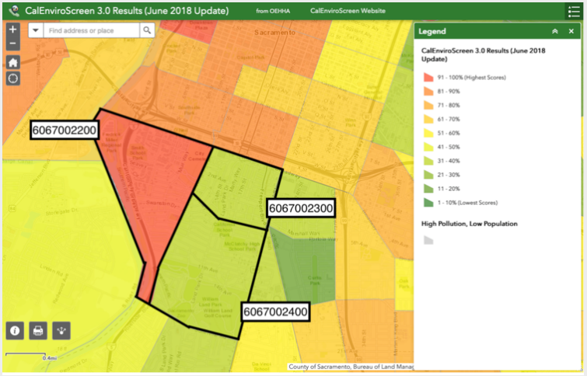
Cullenwald’s Critique
Inaccurate definition of environmental justice communities
- Zipcode vs. neighborhood

Slide 7
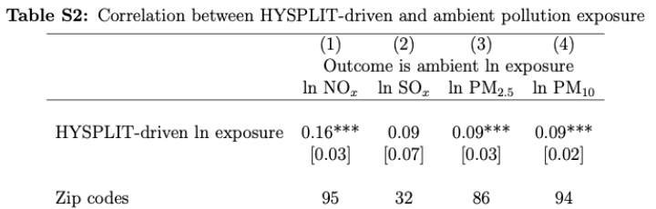
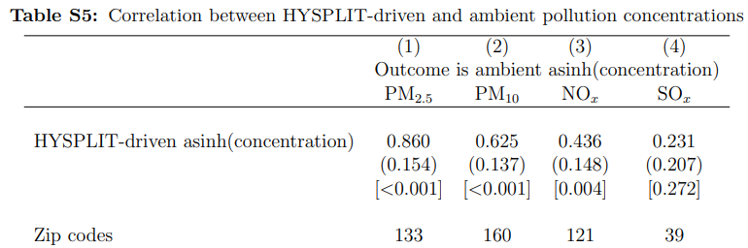
Cullenwald’s Critique
2) Data quality issues with emissions reporting and monitoring
ambient pollution at any location is composed of emissions originating from many sources
2020 paper.
2022 paper.

Slide 8
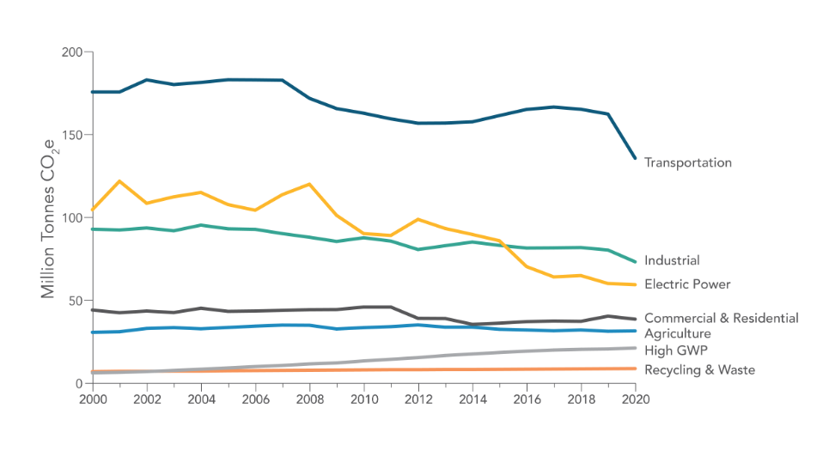
Cullenwald’s Critique
2) Data quality issues with emissions reporting and monitoring
California’s own data show industrial emissions not improving much.

Slide 9
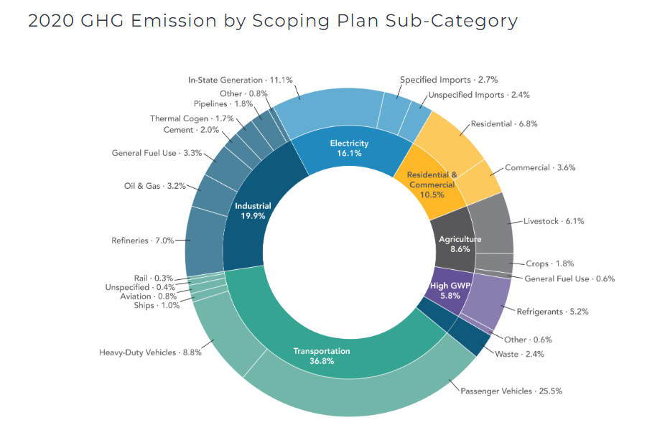
Cullenwald’s Critique
3) Control Group Bias
Facilities over 75th percentile of GHG emissions dropped, all refineries and electricity generators dropped. 70% of reported California 2008-2012 GHG emissions excluded

Slide 10
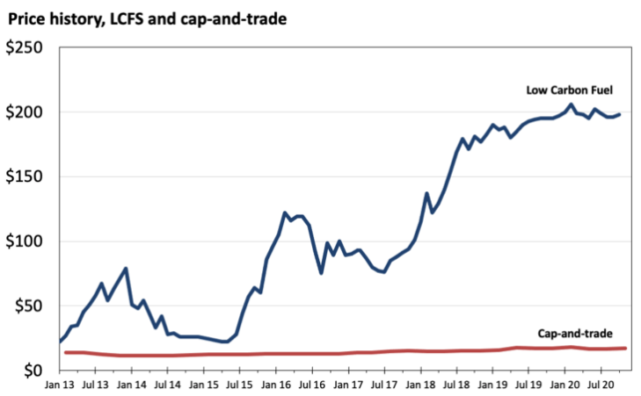
Cullenwald’s Critique
4) Omitted variable bias
Low carbon fuel standards are also a cap and trade at the same time (started 2011). LCFS prices increased rapidly while C&T didn’t move.
C&T price not generally binding
(see Cullenwald et al, 2019).

Slide 11
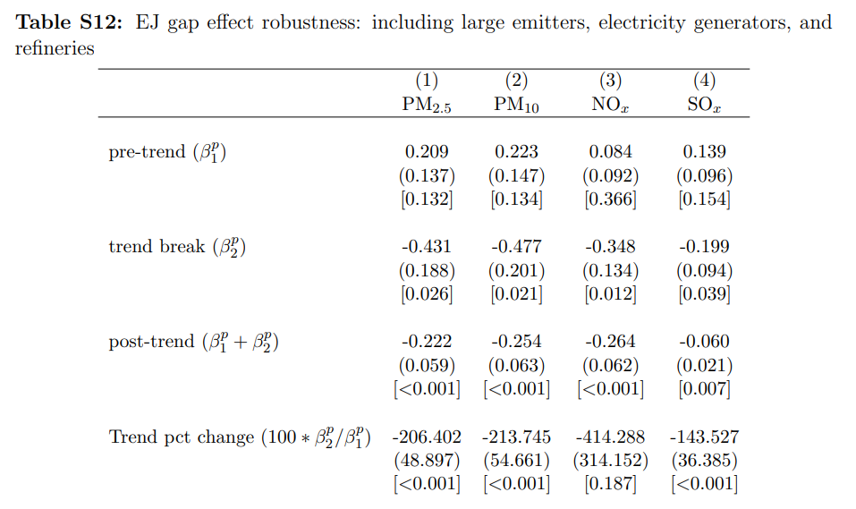
Cullenwald’s Critique
4) Omitted variable bias
Low carbon fuel standards affect refineries, largest sector within industrial category.

Slide 12
Cullenwald’s Critique
5) The question is not cap-and-trade vs. nothing. Argues for:
Stronger cap and trade with fewer allowances
More prescriptive regulations on releasers
More of both policies
“It's not news that a flawed program is better than no program at all, but that's all the paper looks at.”
Notes:
Probably unfair of C&V to say that’s all the paper looks at, or that it’s ‘not news’

Slide 13
Two Perspectives
Adopting a weak cap-and-trade program has led to prolonged and higher emissions in environmental justice communities than if California had adopted a stringent carbon pricing policy or relied instead on non-market mechanisms that would have been targeted at the pollution reductions our communities need.
- Cullenwald and Valenzuela
More generally, despite these findings for California, market-based environmental policies should not be used explicitly to address environmental justice concerns. Market-based policies are intended for allocative efficiency and not distributional objectives… environmental justice problems need environmental justice policies.
- Hernandez-Cortes and Meng
Notes:
Notice that the arguments are speaking past each other to an extent.
Cullenwald and Valenzuela are arguing for a stronger cap-and-trade. They are suggesting HC&M’s paper gives us a false sense of confidence about the positive benefits to EJ communities of a flawed cap and trade
HC&M reduce C&V’s argument to one of ‘more protection for EJ communities’ without addressing that the main point of C&V is ‘more stringent regulations across the board would do more for EJ communities’

Slide 14
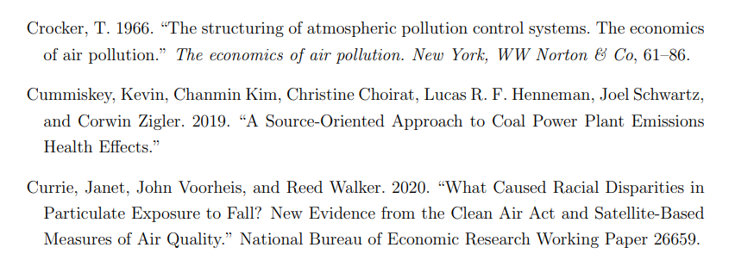
A Response to Cullenwald
!!!

Slide 15
Part 2: Market-Based Instruments in Practice

Slide 16
Market-Based Instruments in Practice
Outline:
EU Emissions Trading System
Other Market-based GHG Policies
Differences Across Policies at Complete GHG Elimination

Slide 17
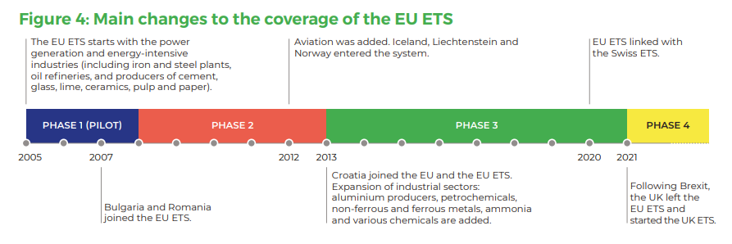
EU Emissions Trading Market
Largest GHG cap-and-trade in the world (before 2021).
Four phases.
27 countries
40% of EU GHGs
12,000 entities
Source: Carbon Market Watch.
Notes:
Phase 1 – all allocations handed out for free.
Phase 2 – 90% allocations handed out for free.
Phase 3 consolidated national-level markets across the entire EU.
More auctions, fewer international offsets.
Phase 4: market stability reserve, no international offsets, new GHG goals

Slide 18
General Features
Carbon neutrality by 2050, 55% net reduction by 2030.
Partly auction (57% as of Phase 3), partly free allowances.
Allowances targeted to protect against leakage.
Heavy industries like steel receive allowances (close to 95% of emissions in heavy industry).
Aviation receives allowances and flights to non-EU states do not count towards total
Electricity generally not eligible for free allowances

Slide 19
Concerns with EU ETS
Early hiccups and other concerns:
Over-allocation of allotments
International offsets
Fraud and misreporting
Windfall profits

Slide 20
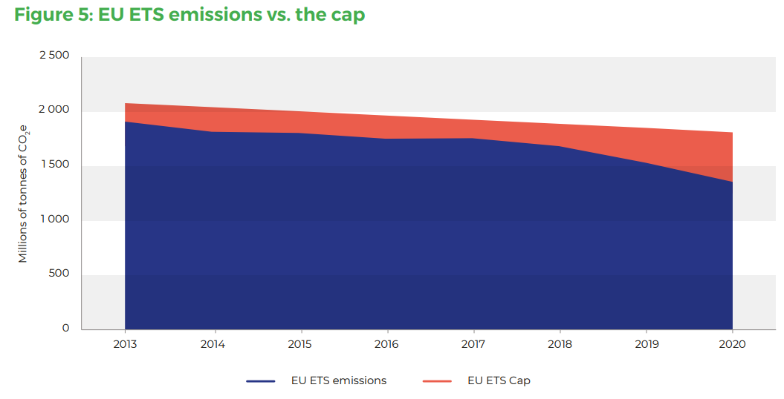
Overallocation of Allotments
Excess credits
Source: Carbon Market Watch.

Slide 21
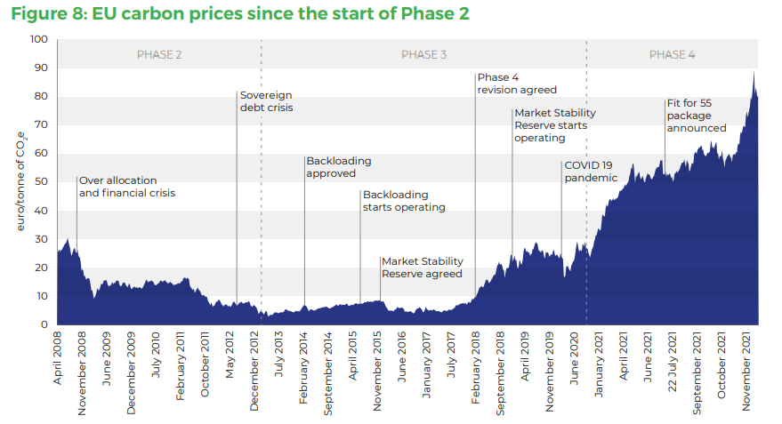
EU Emissions Trading Market Allowance Prices over Time
Over-allocation impacts on prices clearly visible.
Offsets, financial crisis lowering output, high cap led to near collapse of prices in 2014.
Source: Carbon Market Watch.

Slide 22
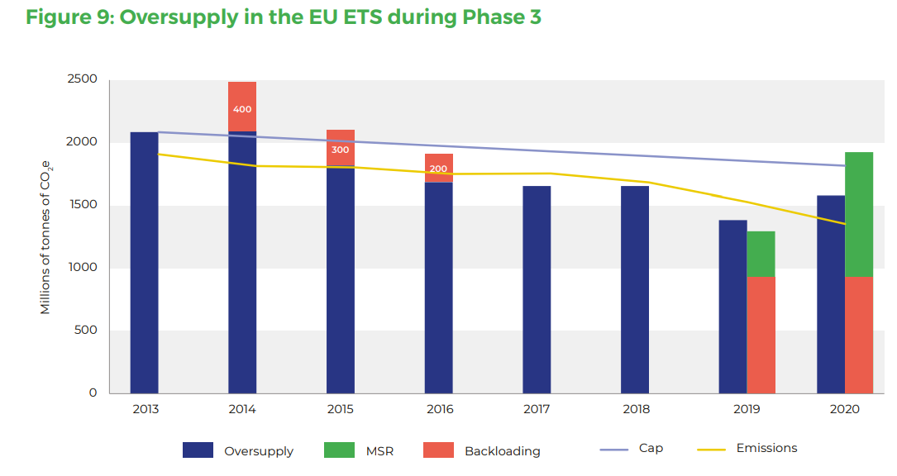
Source: Carbon Market Watch.

Slide 23
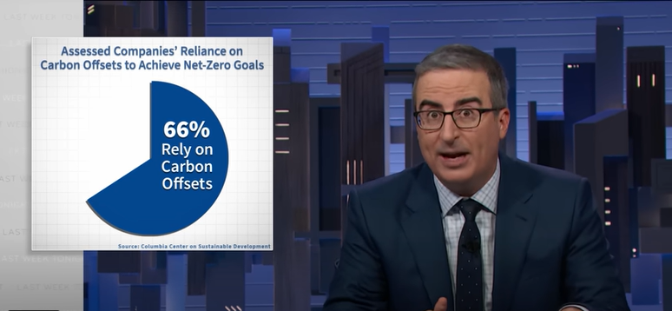
Problems with Offsets
Over 1 billion international offset credits entered the market by 2012. Limited to 500m by 2020.
Why a concern?
Additionality
Permanence
Verification
Great summary of issues with carbon offsets by John Oliver.

Slide 24
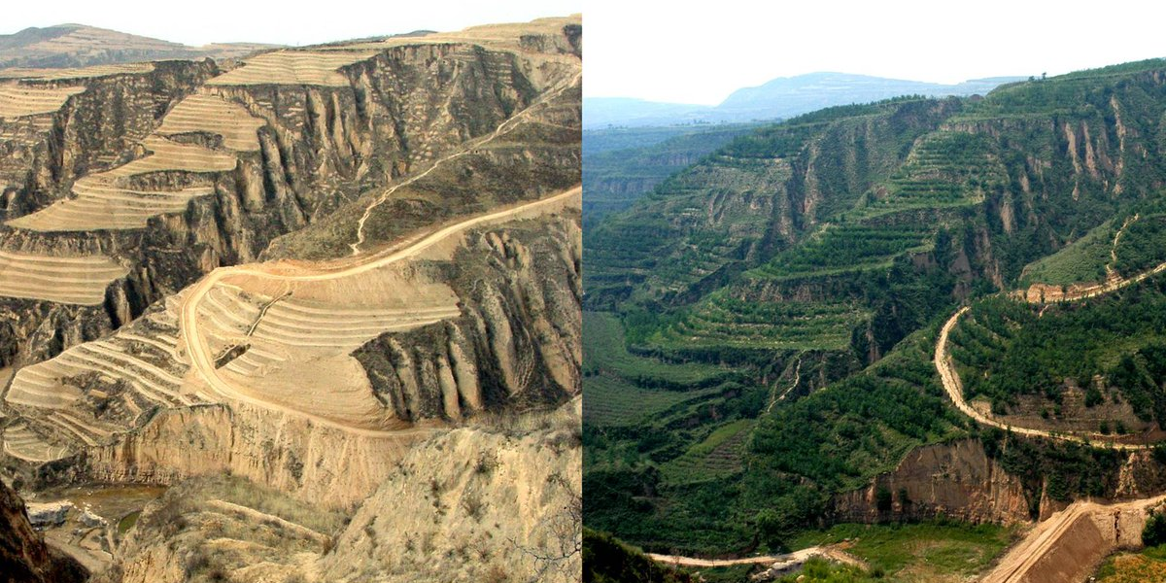

Aside: Planting Trees?
Trillion Trees Initiative & Great Green Wall in the Sahara?
80% of planted trees have died.
Monoculture tree forests susceptible to disease
Ultimately not enough mitigation in trees
7.6 billion tons absorbed by trees of 36 billion tons CO2e
More success with permaculture:
Zai, swales, step irrigation, bunds and water farming in Rajasthan.
Also, paying indigenous cultures to maintain land.
Above: John Liu’s work (see “Regreening the desert” documentary.)
Right:
Zai in Kenya

Slide 25
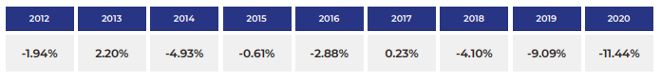
EU ETS Market Stability Reserve
MSR started operation in 2018. Keeps over-supply in check by purchasing allowances:
Some backloaded allowances (that had been pushed from 2013 to later in the decade) purchased by MSR.
Reduces allowances in circulation by a specific share from the prior year excess; will start to retire these in 2023.
International offsets scaled back from 2013-2020 and then prohibited in 2021.
Source: Carbon Market Watch.

Slide 26
EU ETS Other Concerns
Value-added tax fraud:
Companies buy carbon allowances in one country without a VAT, sell in another with the tax (pocket difference).
5B EUR in damages from VAT fraud.
Under-reporting:
30M in under-reported emissions at a Bulgarian coal plant.

Slide 27
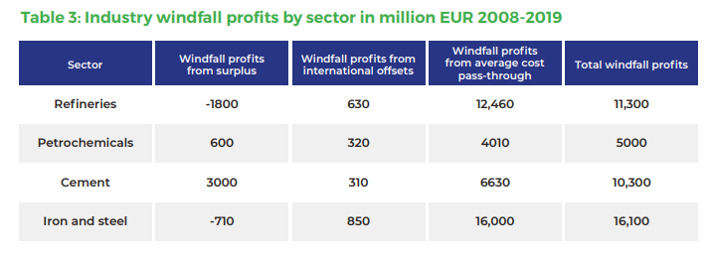
Windfall Profits
In Phase 1 & 2, electricity generators passed opportunity cost of freely-acquired allowances on to consumers in the form of higher prices (Sigm et al., 2006).

Slide 28
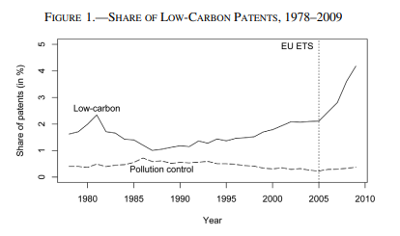
EU ETS Other Features
10% increase in low-carbon patents in industries covered by C&T
Innovation Fund:
Collects 20B EUR from auctions for subsidizing development of low-carbon technologies.
Modernization Fund:
Collects 25B EUR from auctions for modernizing the electricity sector and upgrading the grid in lower-income EU member states.
Source: Calel and Dechezlepetre (2016).

Slide 29
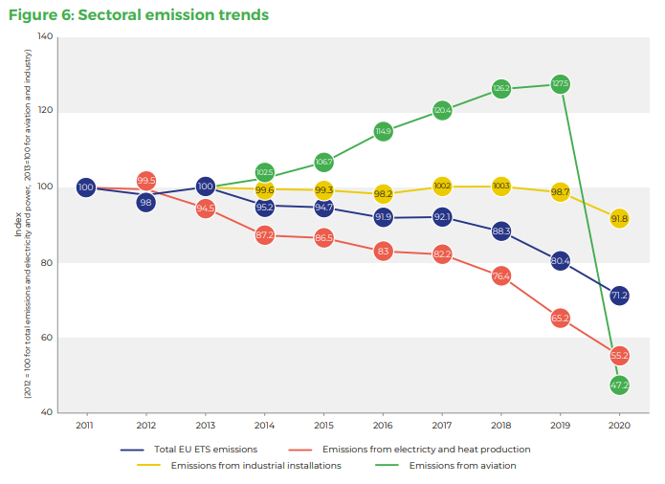
Is it working?
Source: Carbon Market Watch.

Slide 30
Carbon Market-based Policies
in Borenstein and Kellogg (2022)
Carbon pricing
Carbon tax
Cap and trade
Intensity Standard
Emissions intensity standard
Clean energy standard
Subsidizing Clean Energy
Zero-emissions energy subsidies
Zero-emissions capital subsidies

Slide 31
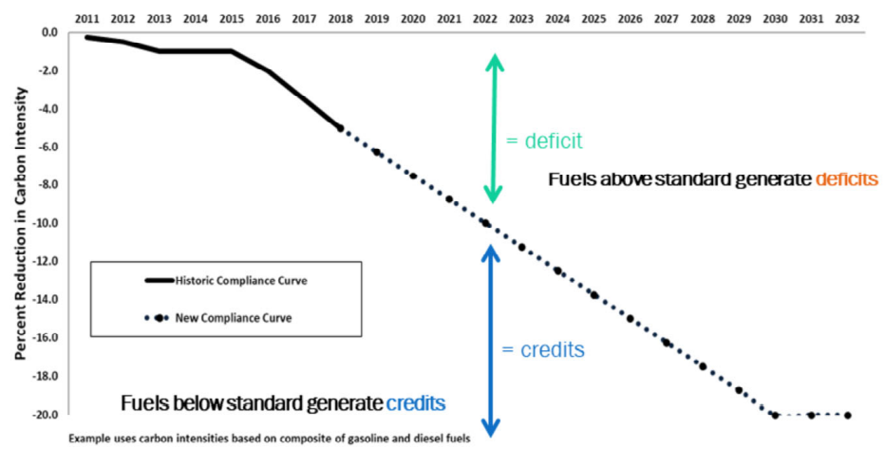
Emissions Intensity Standard
Set target annual carbon intensity standard for gasoline, diesel, and replacement fuels.
Intensity is measured in grams of CO2 per megajoule.
Firms buy and sell until carbon intensity standard is met.
Acts as a tax on higher, and subsidy on lower fuel intensities.

Slide 32
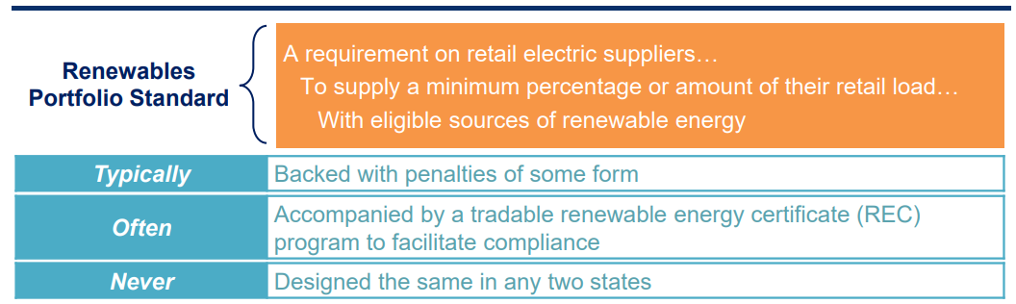
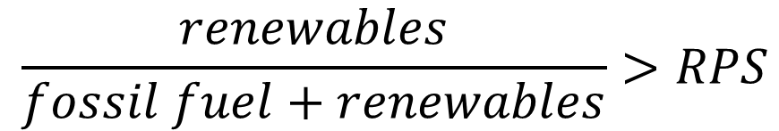
Renewable Portfolio Standards
$$\frac{renewables}{fossil fuel+renewables}>RPS$$
Source: Berkeley Lab (2021).

Slide 33
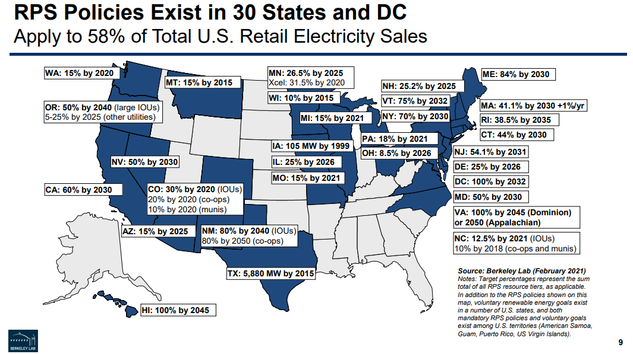
Source: Berkeley Lab (2021).

Slide 34
Source: Berkeley Lab (2021).

Slide 35
Renewable Portfolio Standards
After passage RPSs, reduce emissions 10-25% seven years after revisions to RPS standards.
Electricity prices increase 11%
Cost per ton of abatement is $50-298, generally above $100.
Most costs come from extending transmission lines across states.
i.e., likely more expensive than traditional C&T.
Source: Greenstone and Nath (2020).

Slide 36
Comparing Intensity Standards
Emissions Intensity Standard vs. Clean Energy Standard:
Clean energy standard differentiates between “clean” and “dirty” but not within these categories
Determining which generators produce within category reflects private marginal cost of each generation (not carbon emissions)
EIS has lower emissions but higher prices effect than CES

Slide 37
Comparing Intensity Standards
Pros and cons compared to other carbon strategies:
Lower electricity prices than with carbon pricing, but higher than no standard
Revenue neutral – trading of compliance credits subsidizes cleaner generators and taxes dirtier generators
Higher electricity generation than under carbon tax
Less price volatility but more quantity volatility than an emissions cap, and more price volatility but less quantity volatility than a carbon tax.

Slide 38
Subsidizing Clean Energy
Types of subsidies:
Zero-emission energy subsidy (MWH production tax credit)
Zero-emission capital subsidy (investment tax credit)
Production tax credit vs. investment tax credit
Investment tax credit only subsidizes capital, which does not incentivize the most cost-efficient input mix of capital and labor.
Investment tax credit will be costlier than production tax credit for the government.

Slide 39
Subsidizing Clean Energy
Pros and Cons compared to other market-based policies:
Zero emission energy production tax credit standard differentiates between “clean” and “dirty” but not within these categories
Like clean energy standard but no budget neutrality
ZES has higher generation and higher emissions, but lower electricity prices than CES

Slide 40
Some Caveats
Carbon pricing may not end up being that much more efficient than other market-based policies:
Retail price faced by consumers is substantially higher than wholesale electricity prices due to markups
Since residential prices already exceed total SMC, further electricity price increases induced by carbon pricing would exacerbate the DWL for consumers.
Electricity is increasingly a substitute fuel for transportation
Regressivity of taxes complicates picture

Slide 41
Are Pollution Taxes Regressive?
Pollution regulations, and carbon taxes in particular, likely regressive:
Cost of living as proportion of income is higher
Goods that use energy more expensive
Abatement is capital intensive, affecting capital-labor share of production
Really depends on how the revenue from market-based instruments is used.

Slide 42
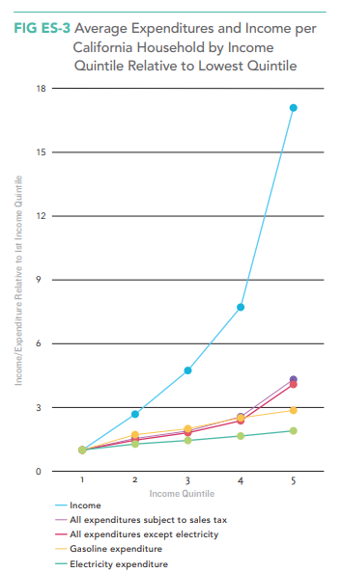
Source: Borenstein, Fowlie, Sallee (2021).

Slide 43
Part 3: Policies under Complete Elimination of GHGs

Slide 44
Complete Elimination of GHGs
At complete elimination of GHGs, or 100% renewables:
C&T, intensity standard and clean electricity standards all have the same:
Electricity price
Electricity generation
Government revenues ($0)
Subsidies have lower electricity price and higher electricity generation

Slide 45
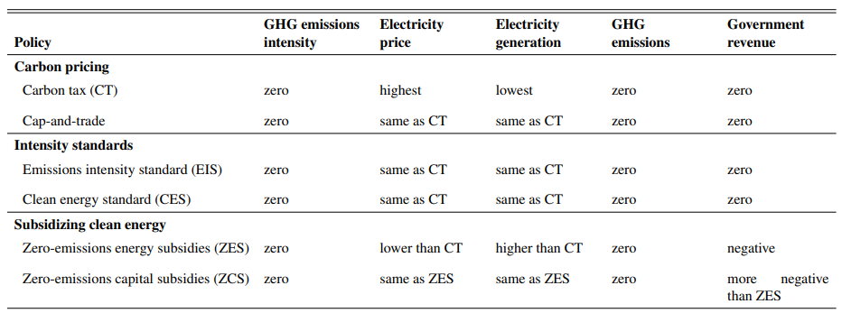
Complete Elimination of GHGs

Slide 46
Complete Elimination of GHGs
Transition Path
We just saw that carbon pricing and intensity standards may be equally efficient at the point of complete elimination of GHGs.
But what about the level of emissions during transition?
Clean energy standard should have higher emissions during transition
Zero-emissions subsidy also has higher emissions, is costlier to the government, lower electricity price and higher consumption

Slide 47
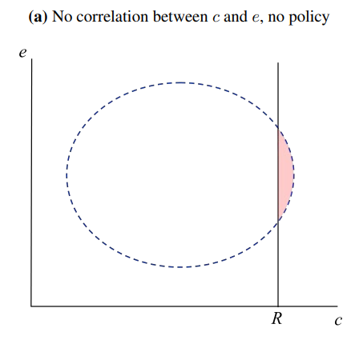
Baseline Conditions
CO2e tons of emissions per MWH
R = Cost of zero-emissions tech
GHG generators priced-out by zero-emission sources
Area = total MWH generated by fossil fuel units
Operating cost per MWH

Slide 48
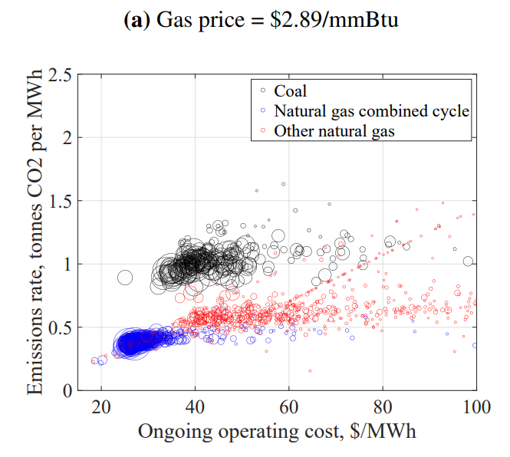
Baseline Conditions
CO2e tons of emissions per MWH
Operating cost per MWH

Slide 49
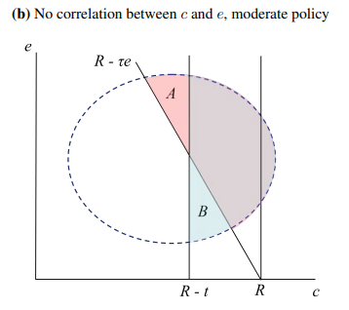
Tax vs. Clean Energy Standard
CO2e tons of emissions per MWH
Add tax t or CES equivalent to t.
Tax: generators with cost te + c > R priced out (A)
CES: Generators with costs t + c > R are priced out (B)
Area = total MWH generated by fossil fuel units
Operating cost per MWH

Slide 50
Tax vs. Clean Energy Standard
A: Highest emission but lower cost generators are priced out
B: Higher cost but lower emissions generators priced out
CO2e tons of emissions per MWH
Area = total MWH generated by fossil fuel units
Operating cost per MWH

Slide 51
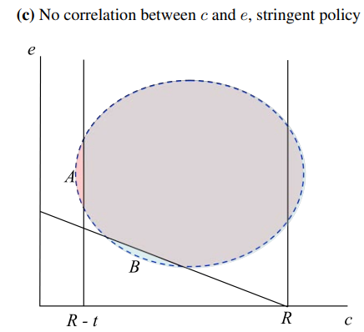
Tax vs. Clean Energy Standard
CO2e tons of emissions per MWH
With strictest policies, less difference between tax and CES.
Operating cost per MWH

Slide 52
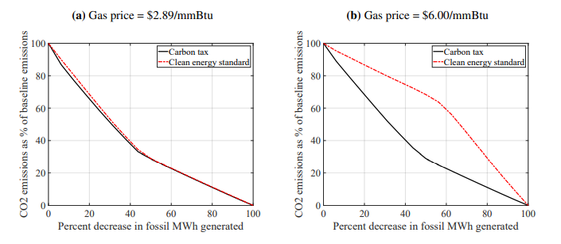
Tax vs. Clean Energy Standard
With lower gas prices, fairly minimal difference between CES and carbon tax. Why?

Slide 53
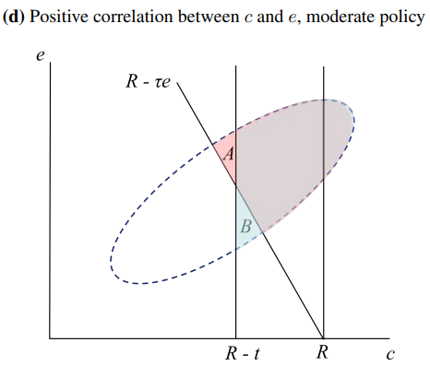
Tax vs. Clean Energy Standard
CO2e tons of emissions per MWH
Both policies push high emissions units out of the market before low emissions units
With positive correlation between c and e, less difference between policies.
Operating cost per MWH

Slide 54
Borenstein and Kellogg (2022)
Conclusions:
With carbon equivalent at zero emissions, tax, cap and trade, and intensity standards have the same efficiency implications.
Relatively low excess emissions of clean energy standard at current gas prices, and yet lower prices.
Lower prices could be efficiency enhancing with high mark-ups.
What about equity?

Slide 55
Next class
Have a nice Thanksgiving. Our next class is one week from today, Monday, November 28th.
Your assigned materials for this lecture are two recent videos in the Resources for the Future seminar series.
WV vs. EPA Video
IRA Video

